Slide 1
Design and Analysis of Algorithms (UE20CS251)
Unit V - Limitations of Algorithm Power and Techniques to cope with
Mr. Channa Bankapur
channabankapur@pes.edu

Slide 2
Ingredients of an introductory course in Algorithms
Design strategies for designing algorithms.
Tools for analyzing algorithms.
Identifying and coping with the limitations of algorithms.
Comparing asymptotic efficiency classes of algorithms:
Unfair comparison: Sequential Search algorithm, whose worst-case time efficiency is O(n), is faster than Mergesort because of its worst-case time efficiency O(n log n).
Fair comparison: Mergesort, whose worst-case time efficiency is O(n log n), is faster than Selection sort because its worst-case time efficiency is O(n²).

Slide 3
Lower Bound: an estimate on a minimum amount of work needed to solve a given problem.
Examples:
Minimum number of comparisons needed to sort an array of size n.
Minimum number of multiplications needed to multiply two n-by-n matrices.
What could be the lowest possible worst-case time efficiency of an algorithm, which solves the sorting problem?
That’s the lower bound for the sorting problem.
For a given problem, there cannot be an algorithm with lesser worst-case efficiency than the lower bound.

Slide 4
Lower bound can be
An exact count.
An efficiency class (Ω)
Tight lower bound: there exists an algorithm with the same efficiency class as the lower bound. We can hope for a constant-factor improvement at best.
Eg: O(n logn) is the lower-bound for comparison-based sorting algorithms and we know O(n logn) sorting algorithms.
Methods for Establishing Lower Bounds
Trivial lower bounds
Information-theoretic arguments (decision trees)
Adversary arguments
Problem reduction

Slide 5
Trivial Lower Bounds: based on counting the number of items that must be processed in input and generated as output.
Examples:
n in searching an element in unordered array
n, degree of the polynomial in Polynomial Evaluation
n in Sorting algorithms
n in Element Uniqueness problem
n² in finding the product of two n-by-n matrices
Remarks:
Not an useful result in most cases.
Be careful in deciding how many elements must be processed.

Slide 6
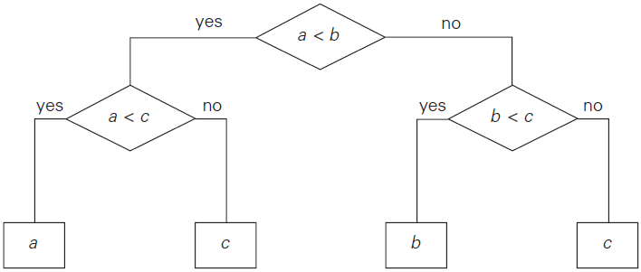
Decision Trees: Comparison-based algorithms can be studied with decision trees.
Each leaf represents a possible outcome of the algorithm’s run on some input of size n.
The number of leaves must be at least as large as the number of possible outcomes.

Slide 7
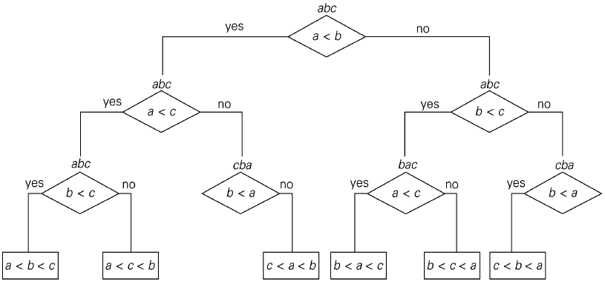
Comparison-based sorting algorithms
Sorting can be interpreted as finding a permutation of the list of n items which is in a desired order.
The number of possible outcomes is n!

Slide 8
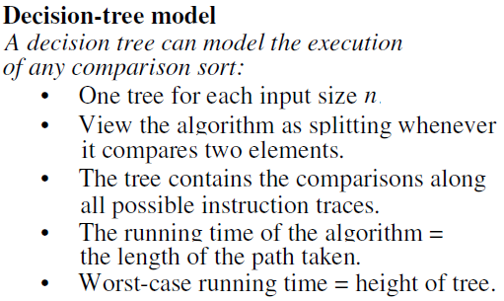

Slide 9

The algorithm’s work on a particular input of size n can be traced by a path from the root to a leaf in its decision tree, and the number of comparisons made by the algorithm on such a run is equal to the length of this path. Hence, the number of comparisons in the worst case is equal to the height of the algorithm’s decision tree.
A tree with a given number of leaves, which is dictated by the number of possible outcomes, has to be tall enough to have that many leaves. Specifically, it is not difficult to prove that for any binary tree with l leaves and height h,

Slide 10
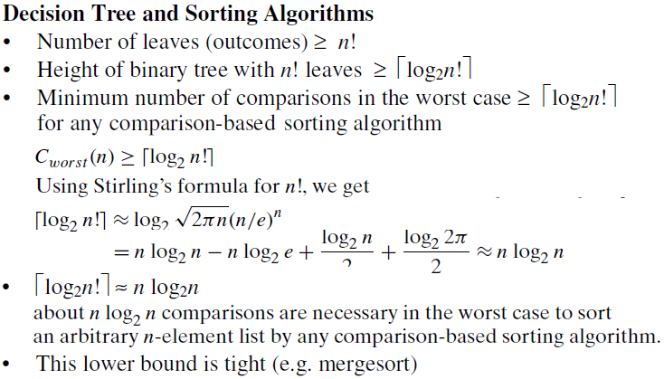

Slide 11
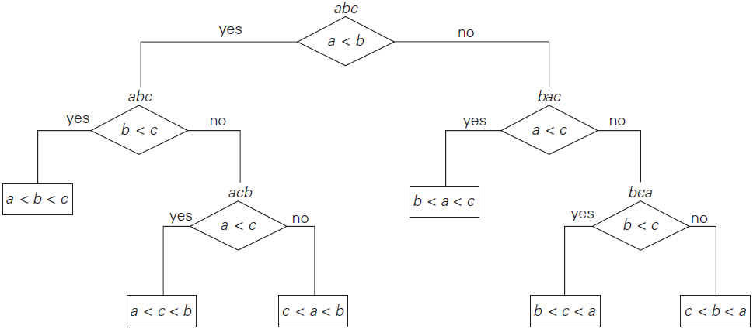
Decision tree for the three-element insertion sort
Average-case efficiency = Average depth of the leaves
= (2 + 3 + 3 + 2 + 3 + 3)/6 = 2.66

Slide 12
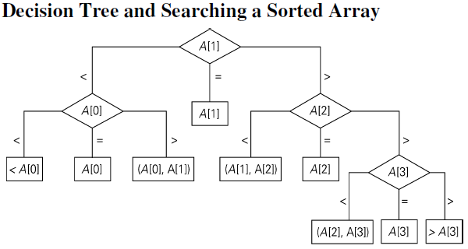

Slide 13
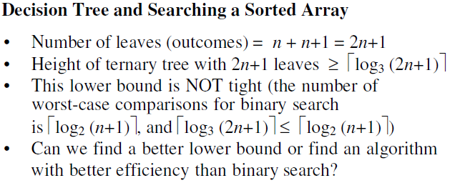

Slide 14
Problem | Lower bound | Tightness
sorting | Ω(n log n) | yes
searching in a sorted array | Ω(log n) | yes
element uniqueness | Ω(n log n) | yes
n-digit integer multiplication | Ω(n) | unknown
multiplication of n-by-n matrices | Ω(n²) | unknown

Slide 15
Adversary argument: a method of proving a lower bound by
playing role of adversary that makes algorithm work the hardest by adjusting input.
Example: “Guessing” a number between 1 and n with yes/no
questions
Adversary: Puts the number in a larger of the two subsets generated by last question

Slide 16
Lower Bounds by Problem Reduction
If problem P is at least as hard as problem Q, then the lower bound of Q is also a lower bound for P. Hence, find problem Q with a known lower bound that can be reduced to problem P in question.
Example: P is finding Euclidean MST for n points in Cartesian plane and Q is element uniqueness problem, which is known to be in O(nlogn). Therefore, a lower bound for Euclidean MST is also O(nlogn).
P (E-MST) is at least as hard as Q (element uniqueness problem) because any instance of Q can be mapped to an instance of P by considering (x_{i} , 0) as coordinates of P where x_{i} ’s are elements of Q.

Slide 17
P, NP and NP-complete Problems:
Undecidable problems are unsolvable problems. They are those that cannot be solved at all by any algorithm. Eg: Halting Problem.
There are decidable, but not every decision problem can be solved in polynomial time.
We say that an algorithm solves a problem in polynomial time if its worst-case time efficiency belongs to O(p(n)) where p(n) is a polynomial of the problem’s input size n.
Problems that can be solved in polynomial time are called tractable, and problems that cannot be solved in polynomial time are called intractable.

Slide 18
P, NP and NP-complete Problems:
We have a long list of problems, which are decidable, but it’s not yet proved if they are intractable or not.
Hamiltonian Circuit
Knapsack Problem
Graph Coloring
Class P is a class of decision problems that can be solved in polynomial time by (deterministic) algorithms.

Slide 19
Hamiltonian Circuit:
Determine whether a given graph has a circuit having all the vertices exactly once.
We know an exponential-time algorithm, but no polynomial-time algorithm.
Interestingly, determining whether there is an Eulerian circuit in a given graph has a polynomial-time algorithm.
Though determining a Hamiltonian circuit doesn’t have a polynomial-time algorithm (yet!), validating whether the proposed solution actually solves the problem can be done in polynomial-time.
Does a problem which can be verified in polynomial-time always has a polynomial-time algorithm to solve the problem in the first place?

Slide 20
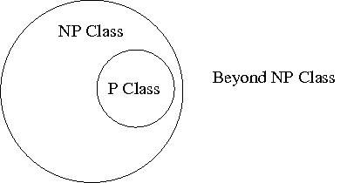
Class NP is the class of decision problems that has a solution found by a nondeterministic polynomial-time algorithm. That is, a given solution can be verified by a (deterministic) polynomial-time algorithm. This class of problems are called nondeterministic polynomial (NP).
Eg: Finding Hamiltonian Circuit
P ⊆ NP because problems
in Class P can also be
verified in polynomial-time.
Cook’s theorem (1971): CNF-SAT is NP-complete
Examples of NP-complete problems: Hamilton Circuit, k-Clique, Knapsack, Graph-coloring and hundreds of other problems.

Slide 21
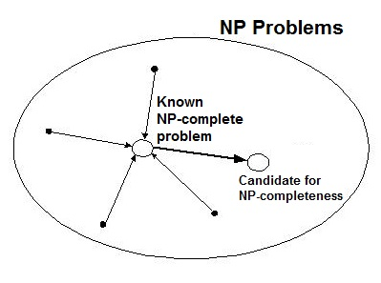
An NP-complete Problem is a problem in NP that is as hard as any other problem in this class because any other problem in NP can be reduced to it in polynomial-time.
To prove a new problem which is NP is also NP-complete, it needs to show that an already known NP-complete problem can be reduced to the problem in question.

Slide 22
NP-completeness implies that if there exists a deterministic polynomial-time algorithm for just one NP-complete problem, then every problem in NP can be solved in polynomial-time by a deterministic algorithm, and hence P = NP.
Though it is most likely P ≠ NP, it is not proved yet.
P ≟ NP (it’s a million dollar question!)
In practice, whenever you come across a NP-complete problem, it’s wiser to find ways to cope with it than trying to find a polynomial-time algorithm unless you are aiming for a Turing Award!

Slide 23
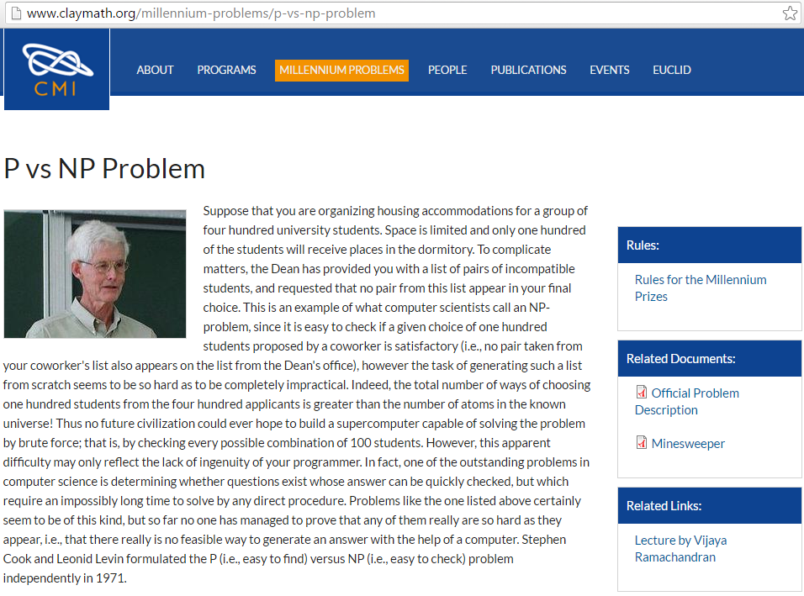

Slide 24
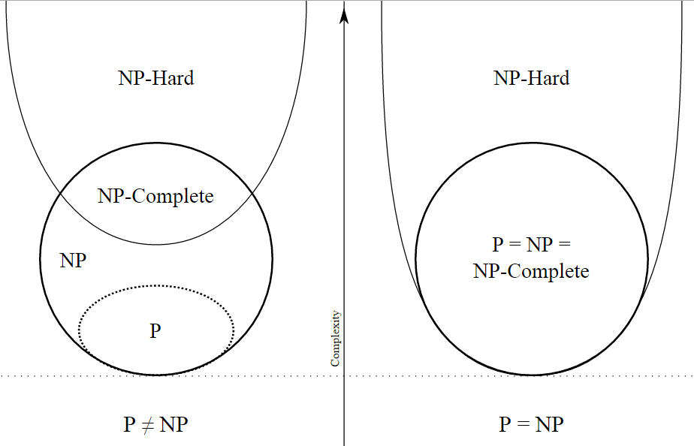

Slide 25
Coping with the Limitations of Algorithm Power
How to tackle NP-hard problems?
Exact algorithms
Exhaustive Search
Useful only for small instances
Backtracking
Eliminates infeasible cases quickly
Branch and Bound
Refined idea of backtracking for optimization problems
Approximation algorithms
Near-optimal solution in polynomial time
Greedy approaches

Slide 26
Approximation Algorithms for NP-Hard Problems
For NP-hard problems, there are no known polynomial-time algorithms.
For some of these problems, a faster algorithm could exist which may not give an optimal solution all the time. Such Approximation Algorithms are sensible for some applications which otherwise has a NP-hard problem.
Eg: Travelling Salesman Problem, Knapsack Problem

Slide 27
Limitations keep mortals mortal!
</
Limitations of Algorithm Power and
Coping with the Limitations of Algorithm Power
>

